Slide 1
Hate Speech Detection in Tweets using Machine Learning Models
Pardeep Kumar
Mentor: Dipanjan Sarkar
Capstone Project 2
Milestone Report 1

Slide 2
Objective
Detecting hateful and offensive language in twitter data using:
Decision Trees
Neural Networks
Classifier comparison based on performance metrics and computation speed

Slide 3
Problem Statement
Multiclass Classification Problem
Classifying tweets under one of the following classes:
Hate speech
Offensive speech
Neutral speech
Micro F1-Score as the performance metric for the classifiers

Slide 4
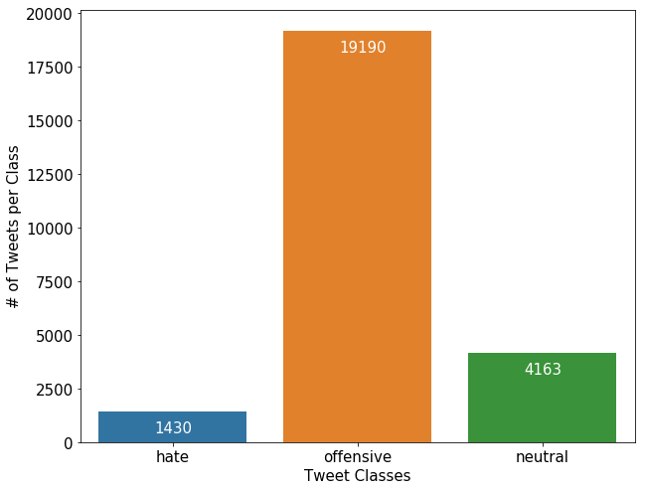
Data Mining
Collection of 24,784 tweets
Tweets classified under three categories
0 – Hate speech
1 – Offensive speech
2 – Neutral speech
Highly imbalanced Classes distribution:
77% offensive tweets
17% neutral tweets
6% hateful tweets

Slide 5
Text Preprocessing
Following features were removed from the tweet during preprocessing:
Username
Web address
Retweet Character (‘RT’)
Punctuations
Emoticons
Numeric data
Stop words: words like a, an and the.
All characters lowercase

Slide 6
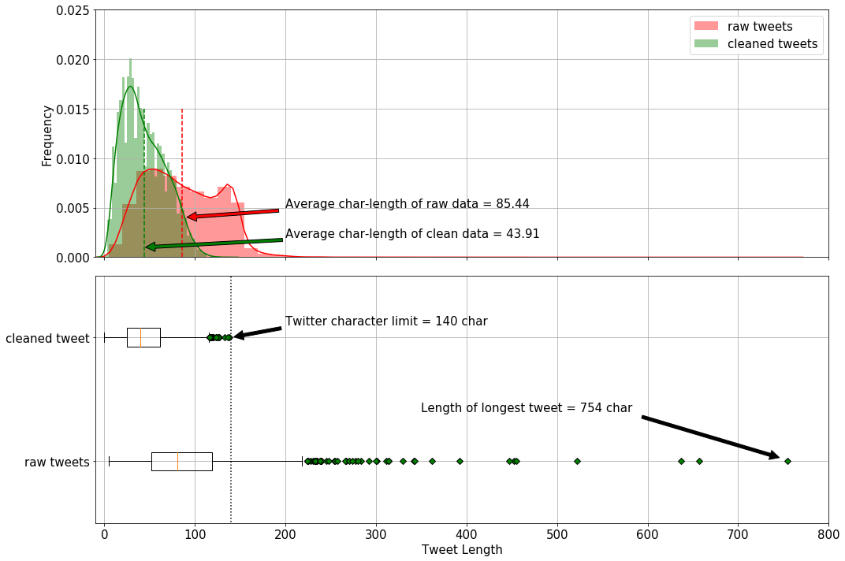
Processed Data Character Length

Slide 7
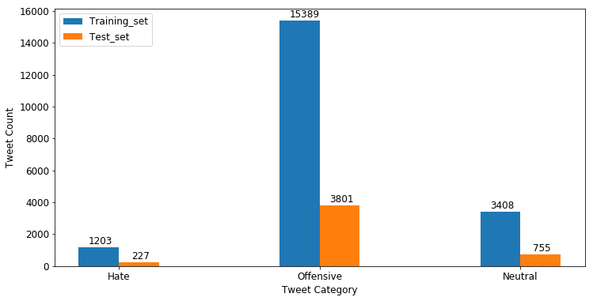
Training, and Test Sets

Slide 8
Word-Vector Representation
Bag-of-word model:
Based on word count
Words represented as one hot encoded vectors

Slide 9

TF-IDF Algorithm
The count of more frequently co-occurring words is crucial
Words that are more frequent lack of any useful information, e.g., stop words
Term Frequency – Inverse Document Frequency Algorithm (TF-IDF) algorithm can balance the two paradox to obtain an updated new-matrix.
Each entry in the updated matrix is the product of the term-frequency and the inverse document frequency
$$C_{t,d}^{updated}={tf}_{t,d}×{idf}_{t,d}$$

Slide 10
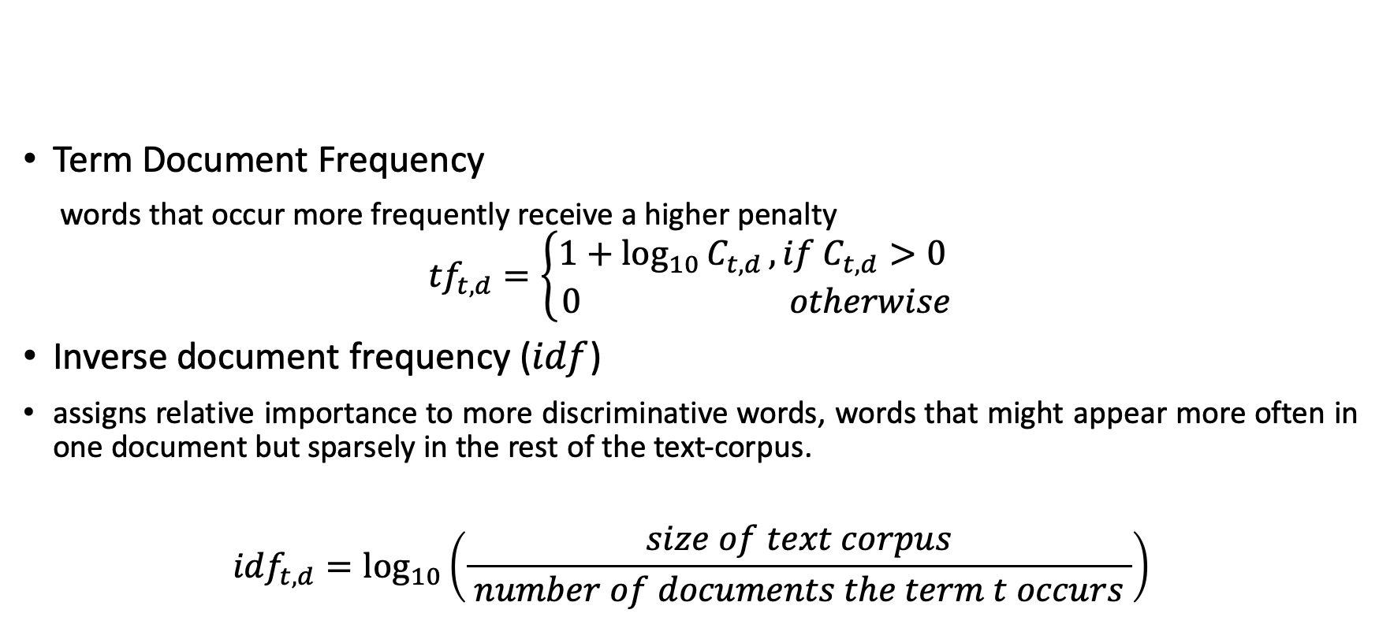
TF-IDF Algorithm
Term Document Frequency
words that occur more frequently receive a higher penalty
$${tf}_{t,d}=\left\{\begin{matrix}1+\log_{10}{C_{t,d}}, if C_{t,d}>0 \\ 0 otherwise\end{matrix}\right.$$
Inverse document frequency ($idf$)
assigns relative importance to more discriminative words, words that might appear more often in one document but sparsely in the rest of the text-corpus.
$${idf}_{t,d}=\log_{10}\left(\frac{size of text corpus}{ number of documents the term t occurs }\right)$$

Slide 11
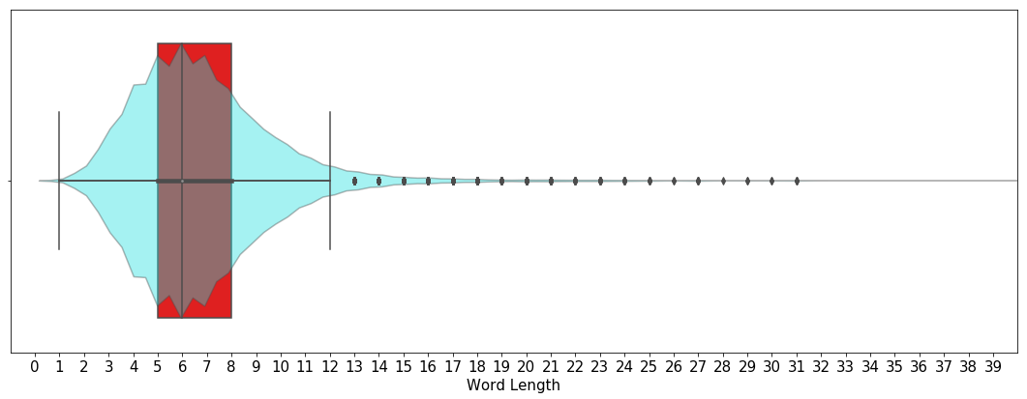

Feature Selection
Average word length = 6
Median word length = 6
Most common word length = 6
8 different N-gram features :
Character level $N$-grams where $N∈\left\{2, 3, 4, 5, 6\right\}$
Word level $N$-grams where $N∈\left\{1, 2, 3\right\}$

Slide 12
Base Models
Majority Class Base Model

Slide 13
Majority Class Base Model
Two simple steps:
Identifies the dominant class is the training data set, and
Assigns dominant class as the prediction to every input in the test set
Same as random guessing for prediction

Slide 14
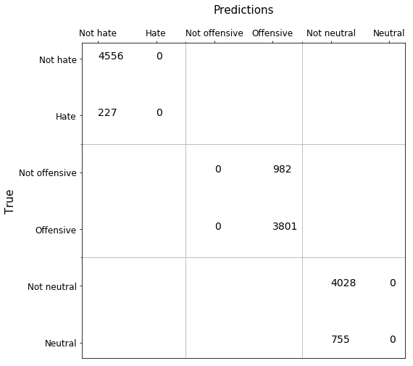
Majority Class Base Model Confusion Matrix

Slide 15
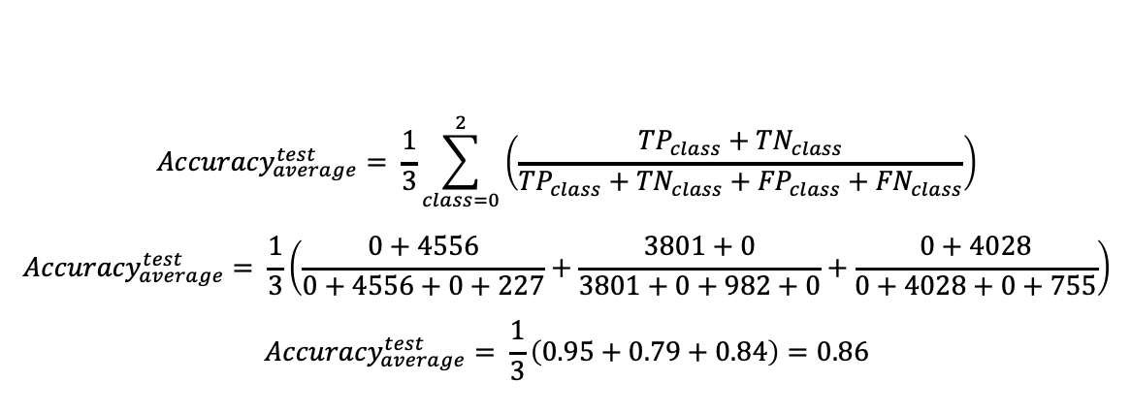
Majority Class Base Model Accuracy
$${Accuracy}_{average}^{test}= \frac{1}{3}\sum_{class=0}^{2}{\left(\frac{{TP}_{class}+{TN}_{class}}{{TP}_{class}+{TN}_{class}+{FP}_{class}+{FN}_{class}}\right)}$$
$${Accuracy}_{average}^{test}= \frac{1}{3}\left(\frac{0+4556}{0+4556+0+227}+\frac{3801+0}{3801+0+982+0}+\frac{0+4028}{0+4028+0+755}\right)$$
$${Accuracy}_{average}^{test}= \frac{1}{3}\left(0.95+0.79+0.84\right)=0.86$$
86% accuracy is rather high for random guessing.
The model accuracy was not a reliable performance measure in the case of imbalanced classes

Slide 16
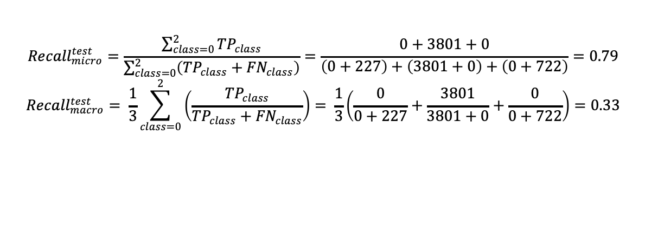
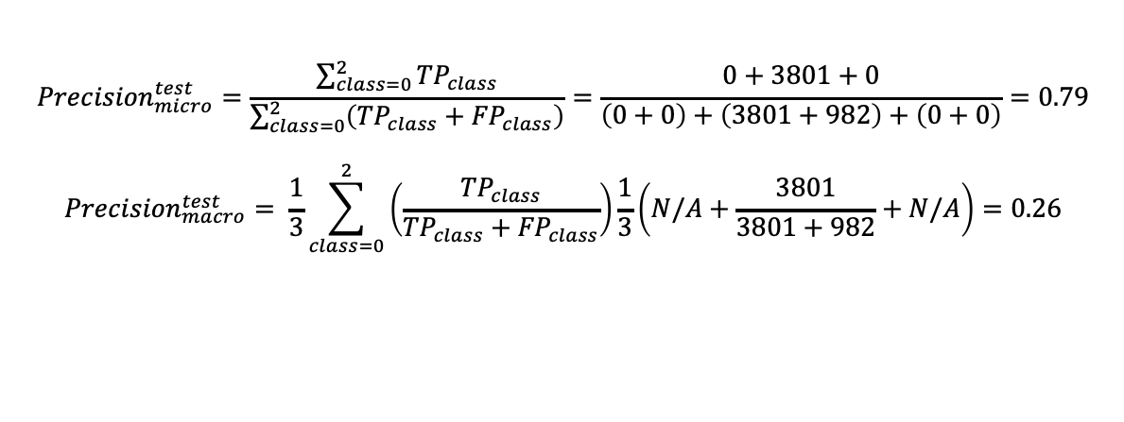
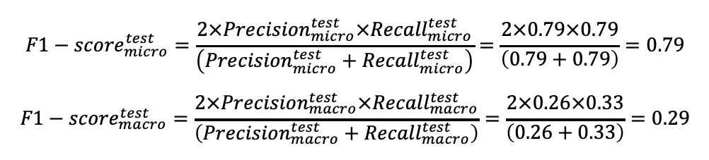
Majority Class Base Model Precision Recall F1- Score
$${Precision}_{micro}^{test}=\frac{\sum_{class=0}^{2}{{TP}_{class}}}{\sum_{class=0}^{2}{\left({TP}_{class}+{FP}_{class}\right)}}=\frac{0+3801+0}{\left(0+0\right)+\left(3801+982\right)+\left(0+0\right)}=0.79$$
$${Precision}_{macro}^{test}= \frac{1}{3}\sum_{class=0}^{2}{\left(\frac{{TP}_{class}}{{TP}_{class}+{FP}_{class}}\right)}\frac{1}{3}\left(N/A+\frac{3801}{3801+982}+N/A\right)=0.26$$
$${Recall}_{micro}^{test}=\frac{\sum_{class=0}^{2}{{TP}_{class}}}{\sum_{class=0}^{2}{\left({TP}_{class}+{FN}_{class}\right)}}=\frac{0+3801+0}{\left(0+227\right)+\left(3801+0\right)+\left(0+722\right)}=0.79$$
$${Recall}_{macro}^{test}= \frac{1}{3}\sum_{class=0}^{2}{\left(\frac{{TP}_{class}}{{TP}_{class}+{FN}_{class}}\right)}= \frac{1}{3}\left(\frac{0}{0+227}+\frac{3801}{3801+0}+\frac{0}{0+722}\right)=0.33$$
$${F1−score}_{micro}^{test}=\frac{2×{Precision}_{micro}^{test}×{Recall}_{micro}^{test}}{\left({Precision}_{micro}^{test}+{Recall}_{micro}^{test}\right)}=\frac{2×0.79×0.79}{\left(0.79+0.79\right)}=0.79$$
$${F1−score}_{macro}^{test}=\frac{2×{Precision}_{macro}^{test}×{Recall}_{macro}^{test}}{\left({Precision}_{macro}^{test}+{Recall}_{macro}^{test}\right)}=\frac{2×0.26×0.33}{\left(0.26+0.33\right)}=0.29$$

Slide 17
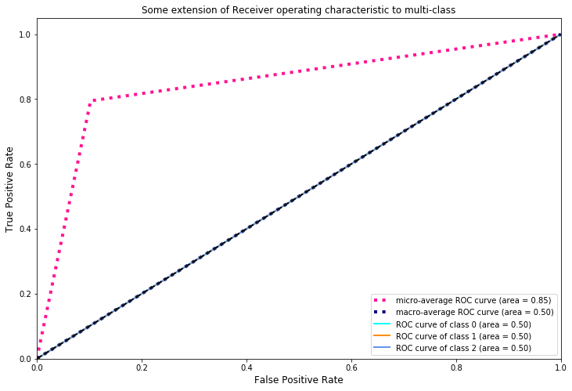
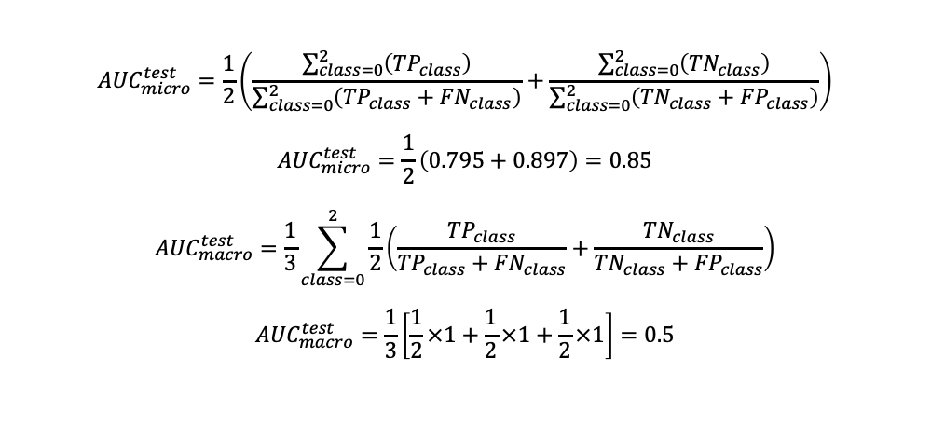
Majority Class Base Model AUC
$${AUC}_{micro}^{test}=\frac{1}{2}\left(\frac{\sum_{class=0}^{2}{\left({TP}_{class}\right)}}{\sum_{class=0}^{2}{\left({TP}_{class}+{FN}_{class}\right)}}+\frac{\sum_{class=0}^{2}{\left({TN}_{class}\right)}}{\sum_{class=0}^{2}{\left({TN}_{class}+{FP}_{class}\right)}}\right)$$
$${AUC}_{micro}^{test}=\frac{1}{2}\left(0.795+0.897\right)=0.85$$
$${AUC}_{macro}^{test}=\frac{1}{3}\sum_{class=0}^{2}{\frac{1}{2}\left(\frac{{TP}_{class}}{{TP}_{class}+{FN}_{class}}+\frac{{TN}_{class}}{{TN}_{class}+{FP}_{class}}\right)}$$
$${AUC}_{macro}^{test}=\frac{1}{3}\left[\frac{1}{2}×1+\frac{1}{2}×1+\frac{1}{2}×1\right]=0.5$$

Slide 18
Decision Trees
Random Forests

Slide 19

Random Forest
Randomly selects a subset of the input features to choose from, at each node
Provides an opportunity for the not-so-strong features to be selected built different trees
On average, $\left(1−f⁄F\right)$ splits will not even consider the strong features for splitting decision, which results in decorrelated decision trees.
Averages from decorrelated trees are less prone to overfitting, making the analysis reliable

Slide 20

Random Forest
Hyper parameter tuning using 5-fold cross validation grid search
Maximum number of features per split
$max_features = \{100,200,500\}$
Total number of trees
$n_estimators =\{500,800,1000\}$
Best Fit Model
$max_{features}= 100, n_{estimators}=500$
Validation Error 0.83

Slide 21
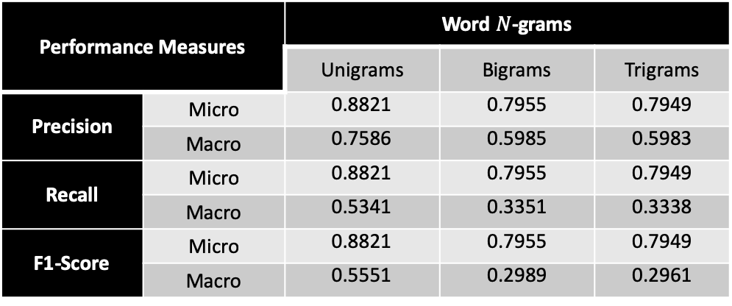
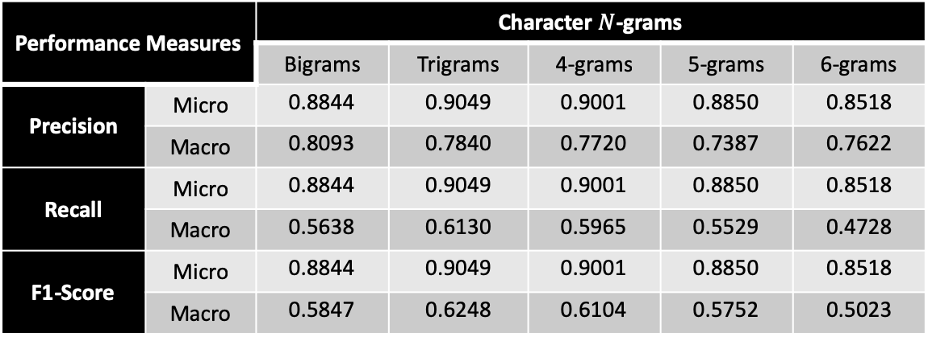
Random Forests Performance
Performance Measures |  | Character $N$-grams
 |  | Bigrams | Trigrams | 4-grams | 5-grams | 6-grams
Precision | Micro | 0.8844 | 0.9049 | 0.9001 | 0.8850 | 0.8518
 | Macro | 0.8093 | 0.7840 | 0.7720 | 0.7387 | 0.7622
Recall | Micro | 0.8844 | 0.9049 | 0.9001 | 0.8850 | 0.8518
 | Macro | 0.5638 | 0.6130 | 0.5965 | 0.5529 | 0.4728
F1-Score | Micro | 0.8844 | 0.9049 | 0.9001 | 0.8850 | 0.8518
 | Macro | 0.5847 | 0.6248 | 0.6104 | 0.5752 | 0.5023
Performance Measures |  | Word $N$-grams
 |  | Unigrams | Bigrams | Trigrams
Precision | Micro | 0.8821 | 0.7955 | 0.7949
 | Macro | 0.7586 | 0.5985 | 0.5983
Recall | Micro | 0.8821 | 0.7955 | 0.7949
 | Macro | 0.5341 | 0.3351 | 0.3338
F1-Score | Micro | 0.8821 | 0.7955 | 0.7949
 | Macro | 0.5551 | 0.2989 | 0.2961

Slide 22
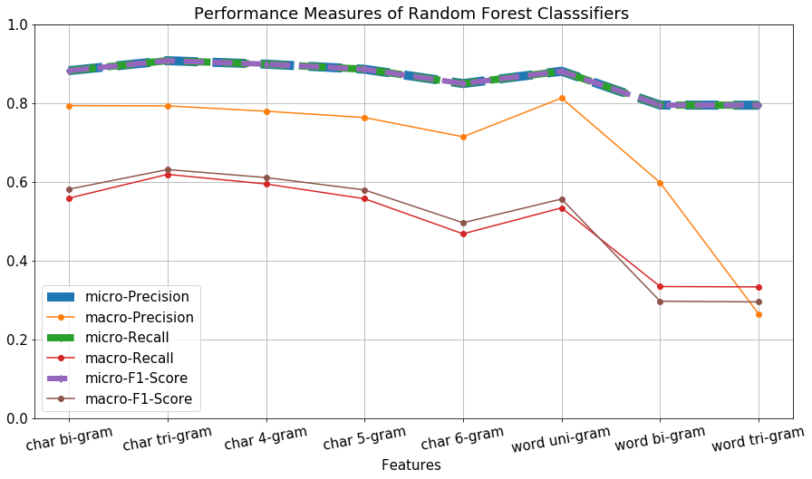
Random Forests Performance Comparison

Slide 23
Thank you

